Slide 1
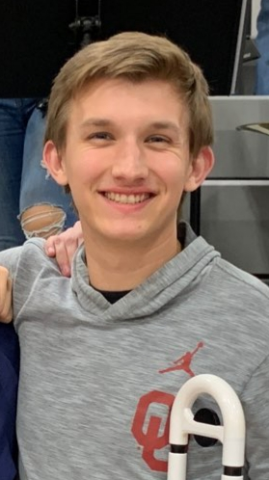
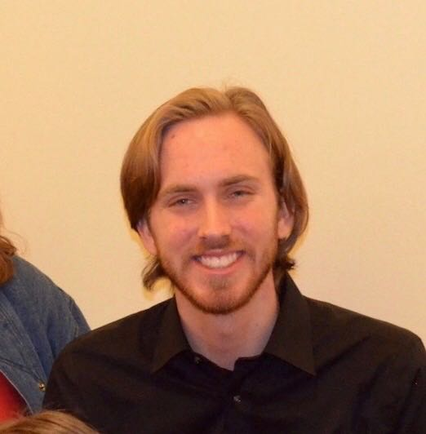
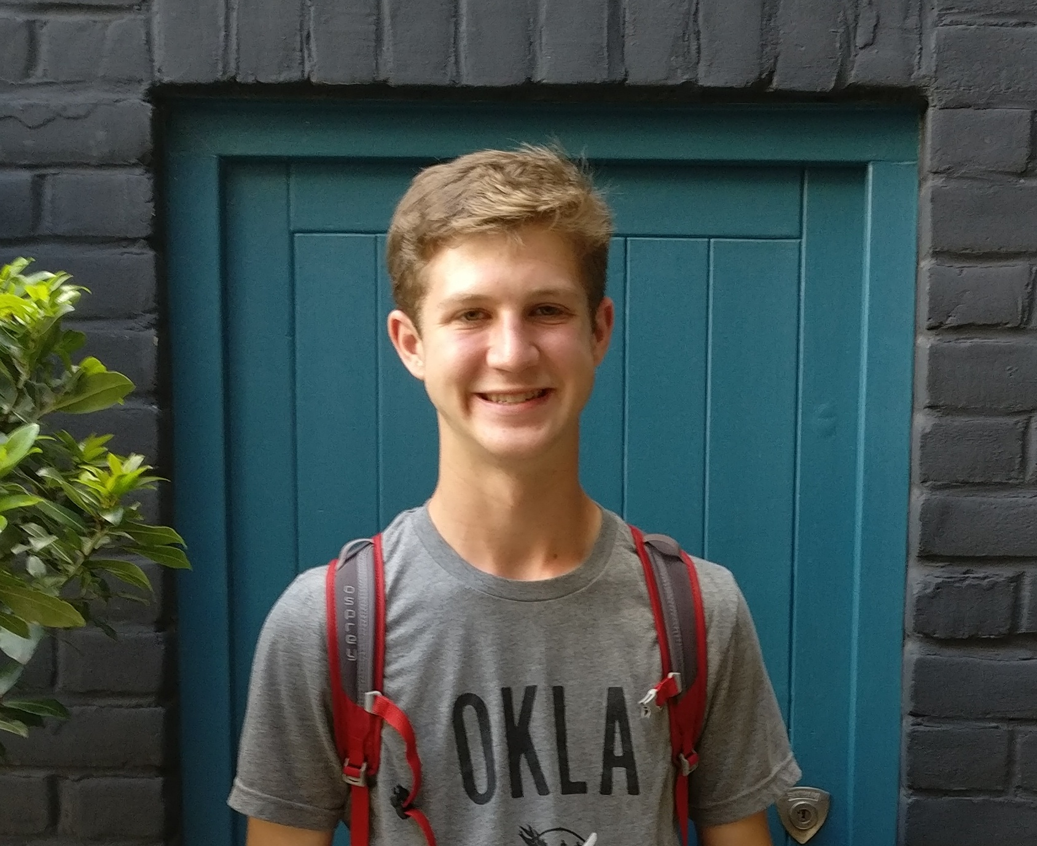

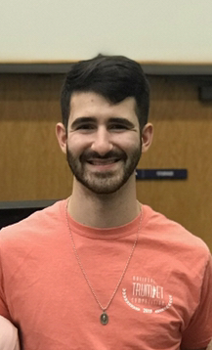

Aural Skills Training Tool
Team 18
HCI Sp20
Jacob Howey – Scottie Curtis – Jack Williams – Noah Brown – Michael Meier
Ear training tool for musicians to work on their interval and pitch recognition
insert video in here

